Slide 1
How to create a Technical Resume
Notes:
Before you begin – do your research about the company

Slide 2
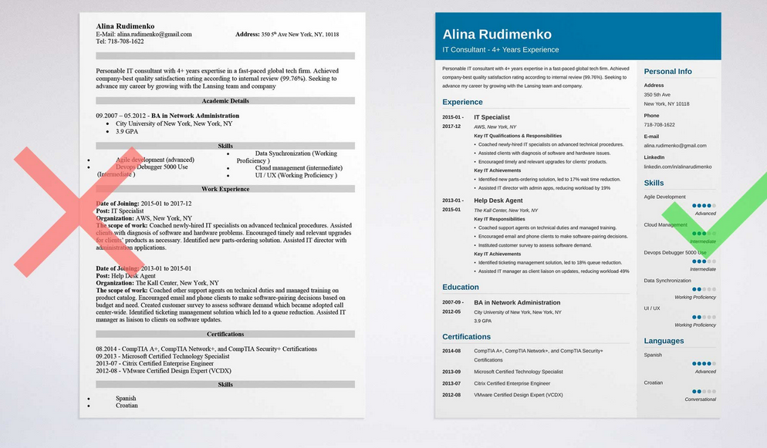
Notes:
This or this? Notice how much room the sidebar on the right gives to the document.

Slide 3
Contact Information
Off to the right hand side
Gives more room for the important stuff
Address
Phone Number (that you are most likely to answer)
Email address – professional email address
LinkedIn account
Notes:
On average, recruiters take just 6 seconds to review a single programming resume
Doc or pdf. Read the job posting to see what file formats are acceptable
https://zety.com/resume-templates#1

Slide 4
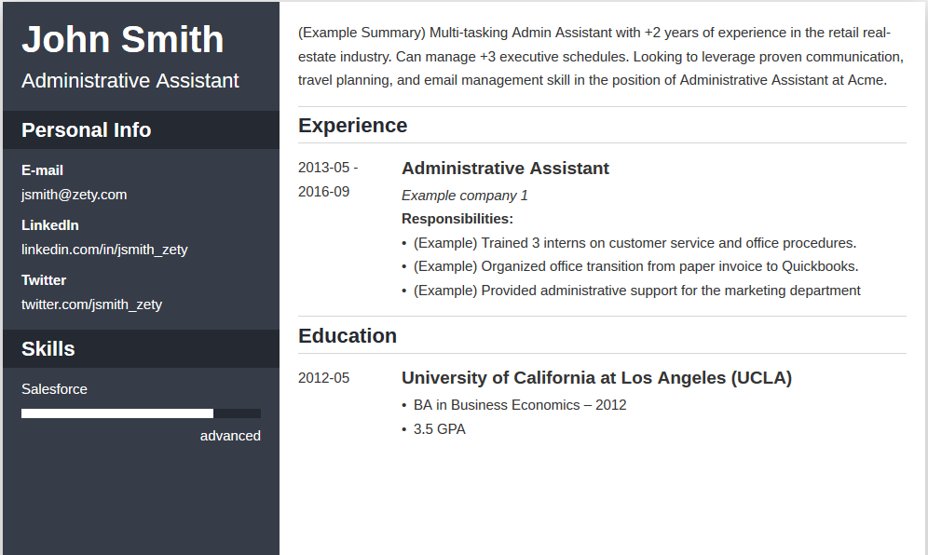
Notes:
https://zety.com/blog/it-resume-example

Slide 5
Create an objective, or not?
Customize for each job
To address the role you want to play in the company
If you use them, Keep the objective clear and concise
If you can tie previous accomplishments or skills to a potential job, do it.
Notes:
Or not. Debate about whether you should include it or not. The side for omitting it says use that space to highlight technical skills. Use that area to create a Summary instead – 2 to 3 sentences that explain why you would be a could fit for that job.

Slide 6
Sample
To obtain a job in satellite development and mission operations where I could use my experience to both make educated decisions about current missions and improve future missions Can program in a large variety of languages including: C++ Python Perl Bash IDL
Notes:
https://zety.com/blog/programmer-resume-example
Lot of information on this site. Don’t write about what “you” want from a job. Instead, write how you can benefit the company with your skills.

Slide 7
Highlight applicable qualifications
Use these qualifications as subheading, following with more specific details
If you list programming as a qualification, then list the types – Java, MySql?
How did you use this expertise in a previous job (if you had one)
Subheadings grab a reader’s attention

Slide 8
List Technical qualifications in which you have experience
Be honest
If you don’t have direct experience with a technical skill, but you believe your training is applicable, then include it and explain how it is applicable
Keywords are fine, just don’t overuse them and make sure they apply
Make these easy to find, have a Technical Summary or Technical Expertise section
Be brief yet complete in listing the skills
Notes:
Definitely have a Technical Skills section

Slide 9
Job Experience
Start with the most recent job
Give the job title and a brief summary of your job responsibilities and achievements
Show how your performance benefited the company –
Such as money savings, faster time-to-market, enhanced efficiency
In specific numbers if you can
Include the company name and contact information

Slide 10
Education and Training
List your college degree (AAS, etc)
Do not include your high school information
Training and certificates may be more important to the employer than education
Notes:
Know what education is required in the job description. It may or may not require a degree. List your highest degree of education, your major, the name and location of your college and graduation dates
Pro Tip: If you have relevant work experience, don’t put your GPA on a resume for a computer programmer role unless the job description asks for it.

Slide 11
Skills and seminars
Include specific technical skills
Include any special seminars or training about new technology that may apply to this job
Notes:
Certifications are great in helping further your knowledge. Don’t list all of them on your resume. List only a few and those that are most relevant to the job you are applying for.

Slide 12
Soft Skills
Employers are looking for candidates with more than just technical skills –
Interpersonal communications
Ability to work collaboratively
Commitment to achieving corporate goals
They are also looking for a “good” match for the team.

Slide 13
New to job market
Consider offering free or low-cost technical services to charitable organizations, friends, family or local businesses
Pursue as much training as possible
Entry-level candidates
Focus on potential in the field
Ability to learn challenging concepts quickly
Motivation to succeed in the industry.
Put education above work experience
In work experience, list side projects, non-paid freelance work, volunteer experience and part-time jobs

Slide 14
Tips
Don’t make the resume too long – 6 pages is never going to be read
Write strong descriptions about your accomplishments not just duties
Keep descriptions short and sweet
Use action verbs avoid passive voice
You “executed, developed or managed”
Avoid – “I helped with” or “I assisted with”
Make it readable
Spell check it
Clean up typos
Proof read it
Use the same font throughout
Use whitespace and bullets to “chunk” your information
Notes:
Keep resume 2 to 3 pages max
Where you can, use metrics to back up your claims. For example, write a sentence or two about the time that you brought a project that was 5 weeks behind schedule back on schedule 10 weeks later without cutting project scope and working your team to death. That’s a pretty impressive feat.
Where you can, link your accomplishments back to the company’s business goals. Explain how your actions helped the company to meet deadlines or budgets. Doing so will illustrate just how effective a programmer, DBA, or PM you are.
Do not exaggerate or lie. If you assisted with a project, then you assisted. If you built this program, then you built this program. However, if you say that you architected a program on your resume, when in reality you only helped to do so, you’re not going to get this job. Don’t overstate what you’ve done.

Slide 15
Tips – cont’d
Use keywords – the ones that are in the job posting itself
Tweak the resume to fit the job – cater to the job application
Technology changes so – don’t list things from 10 years ago –
Just list title, company name and dates
Instead list most recent technology jobs
No more objectives section
Use that space for skills that make you qualified
Have a Summary Section
Summarize why you would be a good fit
Notes:
The interviewer will ask about older jobs
When recruiters/HR need to fill a new role, they enter certain keywords into a database in order to find people whose skills align with the role at hand. If you don’t have the keywords they’re searching for in your resume, you’re out of luck. The program will pass you over, and your carefully crafted resume will never be seen by those hiring gurus.
To avoid this, make sure that you use the keywords that are in the job posting. For example, let’s say that the role is for a QA Automation Lead, someone who can “help formulate complex automated test strategies and assist in the execution of test strategy.” What keywords should you have on your resume? That’s right. Test strategy.
Make sure that you use the keywords, the words that are used in the job postings itself, in order to heighten your chances of being considered for the role.

Slide 16
Tips – cont’d
Have a Skills Section
List those that are relevant to the job first
Certifications
List those that are relevant to the job
Too many and you look scattered
Use reverse chronological format

Slide 17
Beat the 6 second average
Work Experience section:
Start with your current or most recent job. Then, add your previous positions in reverse chronological order.
Under each entry, add up to five bullet points. Focus on your achievements—recruiters are not interested in what you did, but how well you did it.
Show how you can provide value to your employer based on what you’ve done in the past. By tailoring your work experience section so that it matches the job offer.

Slide 18
Sample Java programmer job description
GENERAL DUTIES & RESPONSIBILITIES
Provides design development of projects(1) involving application development, migrations, and additions to existing applications.
Participates in project meetings(2) with other technical staff, business owners and subject matter experts.
Assesses and develops design requirements for project(3) and communicates in writing or in meetings with development team while assessing detailed specifications against design requirements.
Reviews test results(4) and directs further development.
May provide, or guide provision of technical support to applications currently in production.
May mentor or guide(5) work of less experienced programming and development staff.

Slide 19
Java Programmer Resume Work Experience Section
Java Programmer Black Knight Financial Services 2010–2017 Jacksonsville, FL
Designed and developed up to 10 applications projects per year(1)
Designed project requirements(3) in cooperation with data analysis teams
Supervised products testing, reviewed and analyzed test results(4)
Participated in project meetings(2), with technical staff members, business analysts, and external stakeholders.
Trained and mentored(5) over 15 junior programmers and developers
Key achievement: Developed test automation(4) tool that reduced testing time by 55%.
Notes:
Notice how the candidate matched his responsibilities with the highlighted keywords. Used action verbs (highlighted in blue)
Key achievement highlighted.
Used PAR (Problem Action Result) formula:
Problem: testing was too time consuming
Action: developed a tool to automate testing
Result: testing time reduced by 55%.
As programmer need to be quick and efficient.

Slide 20
No Work Experience
Easy to get some programming projects:
Do freelance projects – just ask, you would be surprised
Post your code on Github
Contribute to open source and freeware initiatives
Participate in Hackathons

Slide 21
Projects Section
Focus on relevant projects
If applying to “cool, relaxed start-up”, list some fun and creative projects
Applying to serious corporate tech company, list projects that show programming proficiency and your ability to follow directions
If you don’t have an abundance of projects, for hiring managers listing any projects is better than none
Even projects you had to do for class are worth including on an entry-level programmer resume
Notes:
Considering adding a projects section
Pro Tip: If you put a programming project on your resume, be prepared to answer detailed questions: “What was hard about it?” “What did you learn?” “What was your biggest challenge?” Don't overhype a project and make it sound like you did more than you really did—it will be an instant deal-breaker during the interview.

Slide 22
Listing Programming Skills
Let’s say familiar with 10+ programming languages C, C++, Java, JavaScript, Perl, Python, Go, Visual Basic, HTML, Cobol, Swift, Lua…
You’re probably not expert in all
Tailor to the employer’s needs

Slide 23
How to organize Programming Skils
Start with a spreadsheet and list all your top skills.
Read the job ad and look for skills-related keywords. Those will refer either to programming languages and software skills, or transferable “soft” skills such as timeliness, organization, and teamwork.
Finally, match the skills from your list with those that your employer expects.

Slide 24
How put programmer skills on resume
Example job description for a SAS programmer: Required Skills/Experience:
Minimum 5 years of expert level SAS programming(1)
Minimum 5 years of experience with SAS Enterprise Guide(2)
Experience with SAS scoring(3) and code Accelerator(4) is preferred
Minimum 5 years of practical experience working with large datasets with SAS and/or SQL knowledge
Experience with SAS Management Console is preferred
Work well within a team of analysts(4) and collaborate with individuals with technical and non-technical backgrounds(5)

Slide 25
How to put programming skills on resume
SAS Programmer Resume Example – Skills Section:
Relevant skills:
Advanced knowledge of SAS programming (8+ years of experience)(1)
Proficient in following SAS products:
SAS/Enterprise Guide(2)
SAS Scoring Accelerator(3)
SAS Code Accelerator(4)
Good teamwork skills (worked with teams of 10+ analysts(4), and marketing specialists with limited technical knowledge(5)
Notes:
Pro Tip: As a programmer, you’re obviously a proficient computer user. You don’t need to mention basic software skills on your programmer resume. It would look unprofessional.

Slide 26
Online Portfolio
Put a link
It’s okay to link to social media that is relevant, as in GitHub
If you are an entry-level it’s okay to put hobbies and interests. Shows you are well rounded.
Notes:
Pro Tip: If you feel like you have nothing that makes you glitter, it’s easy to change it. Good project ideas for a programming resume additional section include writing guest posts for an industry blog, taking additional online courses, attending conferences, or participating in hackathons.
Hobbies and Interests:
Individual Sports (Marathon Running) - You're fit and you enjoy challenges.
Team Sports (Basketball) - You excel at teamwork and have leadership skills.
Extreme Sports (Motocross) - A risk taker (bad for desk jobs).
Tech Hobbies (Computing) - Tech savvy and introverted (not great for social jobs).
Puzzles (Crosswords) - You're an analytical thinker with problem-solving skills.
Games (Chess) - You're an intelligent strategist.
Social Hobbies (Mentoring) - You communicate well and connect with others.

Slide 27
Cover Letter or not?
HR expects it
Can tell a story that your resume cannot
Include a short resume summary
Point out how your skills would benefit the company
Notes:
Almost 45 out of 100 recruiters won’t bother to open your job application if there’s no cover letter included.
A Cover Letter is a one-page document you submit in your job application with a resume or a CV. It contains an overview of your work experience most relevant to the job posting. Its purpose is to introduce yourself in a personal, compelling way so that the hiring manage wants to review your resume or CV.

Slide 28
Cover Letter
Heading – contact information
Salutation
Opening Paragraph – get them hooked and make them read on
Second Paragraph – Why you are a perfect fit for the company
Third Paragraph – Why the company is a perfect fit for you
Closing Paragraph
Formal Closing
Postscript
Notes:
Include these sections

Slide 29
Write a Cover Letter
Use a professional cover letter header
Open with a proper greeting/salutation
Write an opening paragraph that grabs attention
Explain why you’re the ideal candidate (second paragraph)
Make your offer in the closing paragraph
Use the right formal closing
Add the postscript (P.S.)
Notes:
Header – valid contact information – phone, professional email. Optional – the address, linkedin
The date
The name of the hiring manager and their professional title
The name of the company to which your are applying.
Salutation – use the person’s name Dear Mr. Thompson. Last name is safest. Do your research about the company.

Slide 30
Paragraph Content – 1st paragraph
The first line is the most important
You want to attract and hold the hiring manager’s attention
Example: As a lifelong enthusiast of XYZ’s marketing initiatives, I was thrilled to see your posting for the position of Digital Marketing Manager. I am positive I can help with XYZ’s upcoming challenges. I have experience with leading successful national online campaigns with budgets over $300,000. What is more, I have succeeded at expanding ABC’s client base by 19% since 2011.
Example: It was no small task to cut costs at Seton Hospital by 32%in just six months. When management challenged me to lead the team toward cost savings with hurting quality, I naturally turned to Lean Training. The biggest challenge? Overcoming the resistance among employees to cut costs in a very human work environment.
Example: As a longtime fan of Cisco's internal certifications, I was excited to see your project manager opening. With my experience cutting costs 55% for VMware while dropping lead times 35% and boosting quality, I think I can help with Cisco's current challenges as I continue to expand my skill set.
Notes:
Start your first line with something about the hiring manager: Your cover letter first paragraph can start with any of these facts about the manager:
Her name.
Something you like about her company.
Her company's biggest needs.
Some facts that prove you'll help her company.
Research, research, research

Slide 31
2nd Paragraph - Why you are a perfect fit
Need to showcase what the hiring manager is looking for
Show that you are going to satisfy most of the job requirements
Show how your skills will help improve the company
Notes:
Write a cover letter for internships - https://zety.com/blog/cover-letter-for-internship

Slide 32
3rd Paragraph
Show the hiring manager why you want this job, not just any job
Start with a company fact – for instance, an upcoming project
Say why you find it interesting
Reiterate that your experience and knowledge will let you succeed with the project

